Slide 1

Object-Oriented Software Analysis & Design (COMP-3220) Lecture 10 State Pattern
School of Computer Science
Faculty of Science
University of Windsor
Dr. Saeed Samet

Slide 2
Intent
The State Pattern allows an object to alter its behavior when its internal state changes.
The object appears to change its class at runtime.
Instead of using large conditional statements (if-else or switch), behavior is delegated to state objects.

Slide 3
Motivation
Consider a system where an object’s behavior depends heavily on its current state.
Examples:
A vending machine
A traffic light
A media player
A TCP connection
An online order

Slide 4
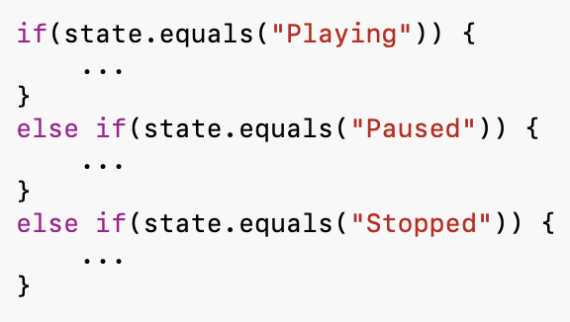
Motivation (Continued)
A naive implementation often looks like:Examples:
As states and behaviors grow:
Code becomes difficult to maintain.
Conditional logic spreads everywhere.
Adding new states requires modifying existing code.
The State Pattern encapsulates state-specific behavior into separate classes.

Slide 5
Problems It Solves
Eliminates large conditional statements.
Encapsulates state-specific behavior.
Makes state transitions explicit.
Simplifies maintenance.
Supports Open/Closed Principle.
Improves readability.

Slide 6
Real-Life Analogy
Music Player
A music player behaves differently depending on its state.
Playing State
Press Play:
Already playing.
Press Pause:
Music pauses.
Paused State
Press Play:
Resume music.
Press Stop:
Stop music.
Stopped State
Press Play:
Start music.
Press Pause:
No effect.
The button behavior depends on the current state.

Slide 7
State Pattern Structure
Main Participants
Context
Maintains the current state.
State
Defines state-specific operations.
Concrete States
Implement behavior for each state.
Client
Interacts with the Context.

Slide 8
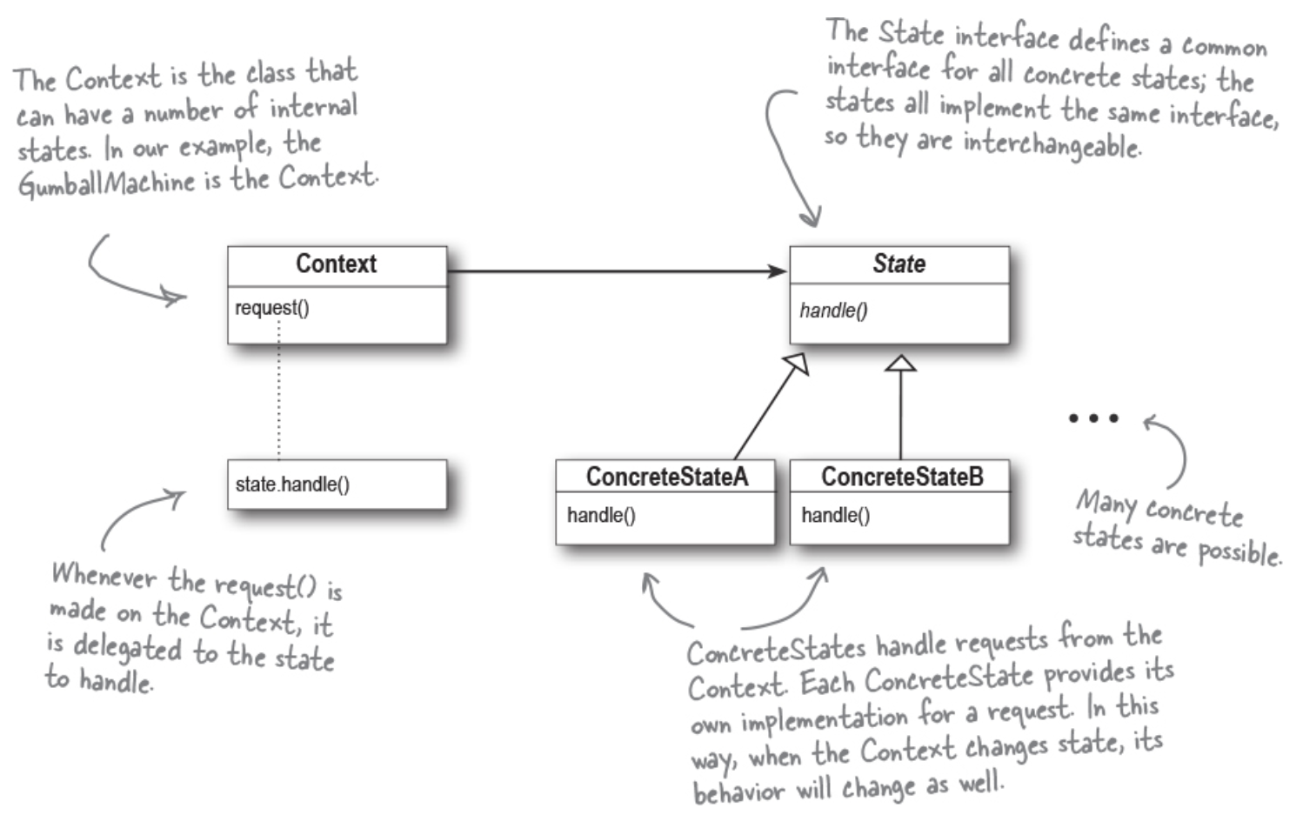
State Pattern – Class Diagram

Slide 9
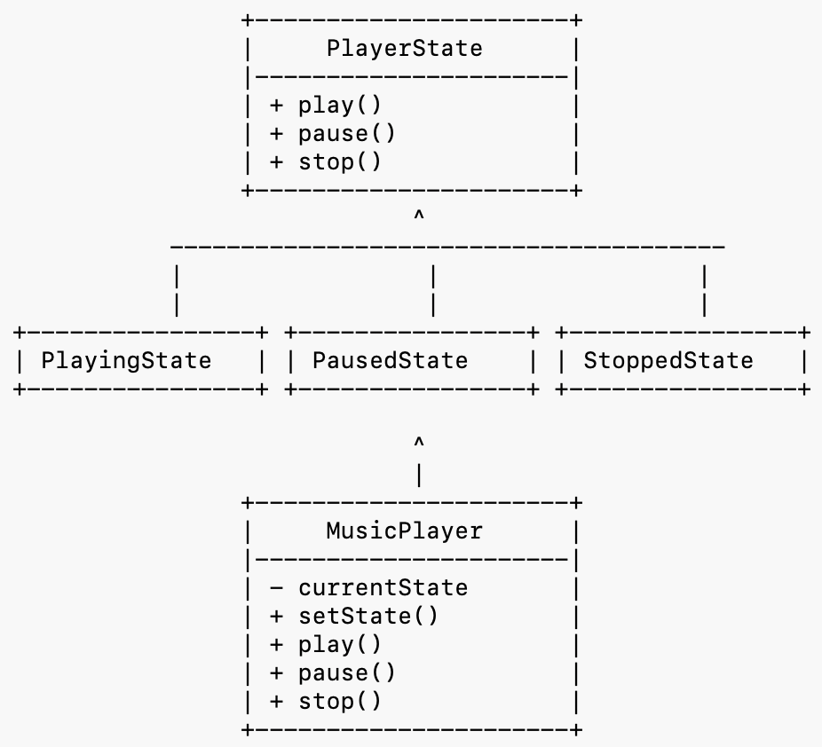
Example: Music Player
States
Playing
Paused
Stopped
The same buttons behave differently depending on the current state.

Slide 10
How It Works
MusicPlayer starts in StoppedState
User presses Play
StoppedState handles request
State changes to PlayingState
User presses Pause
PlayingState handles request
State changes to PausedState
User presses Play again
State changes back to PlayingState

Slide 11
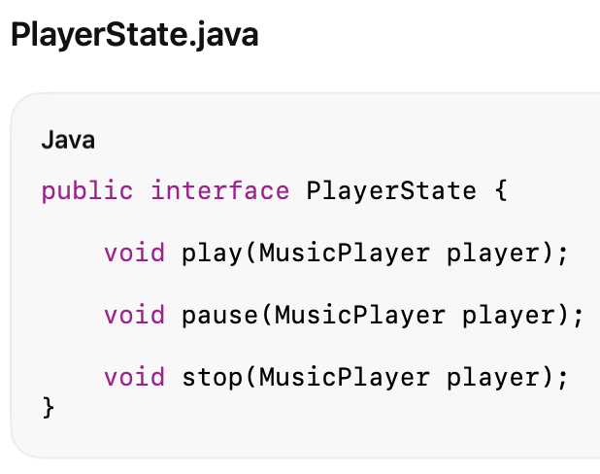
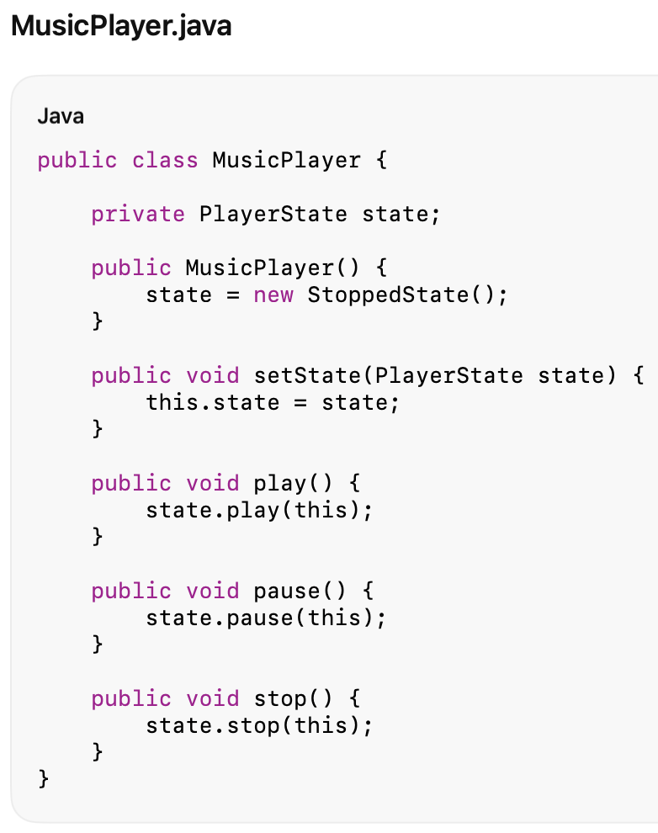
Java Code

Slide 12
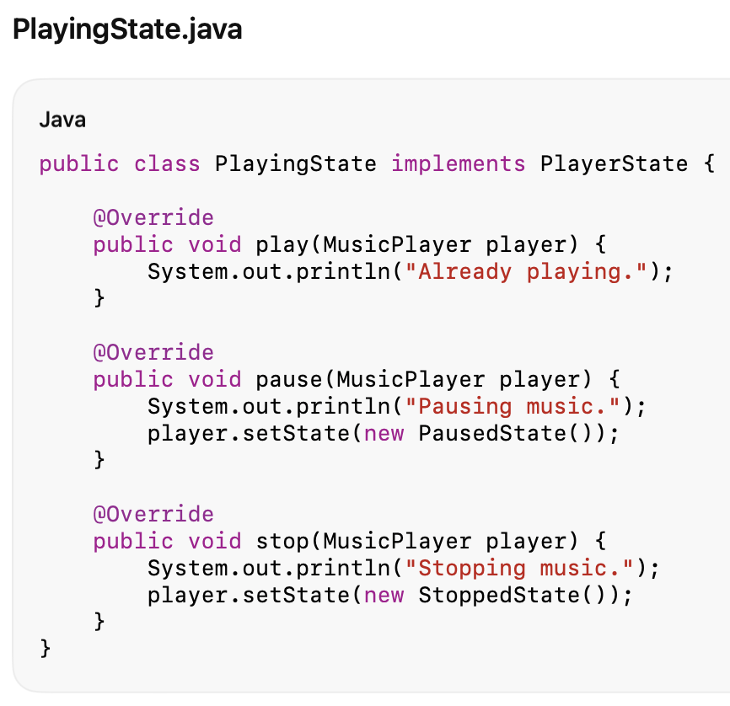
Java Code

Slide 13
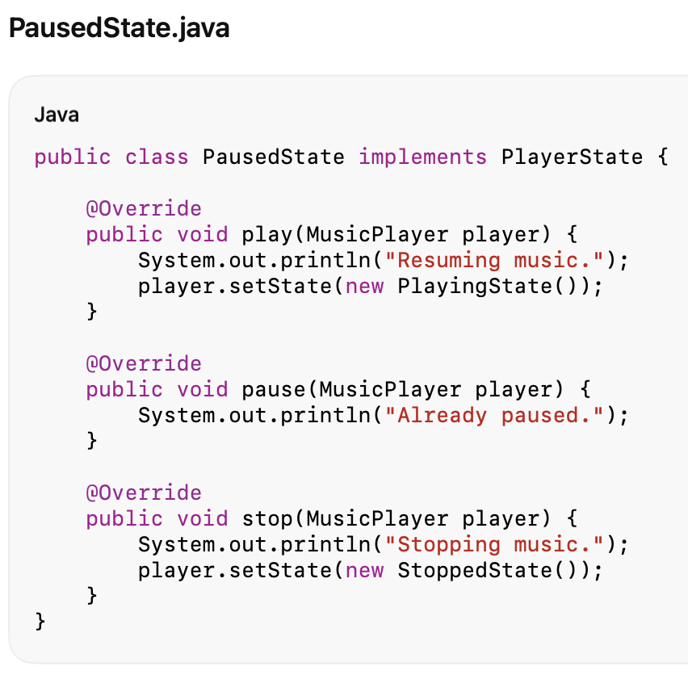
Java Code

Slide 14
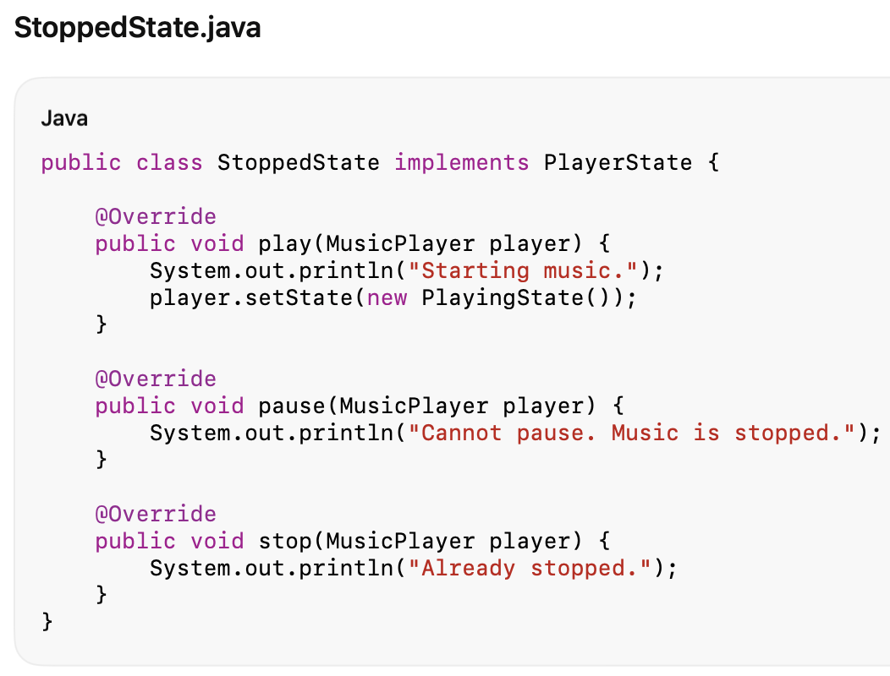
Java Code

Slide 15
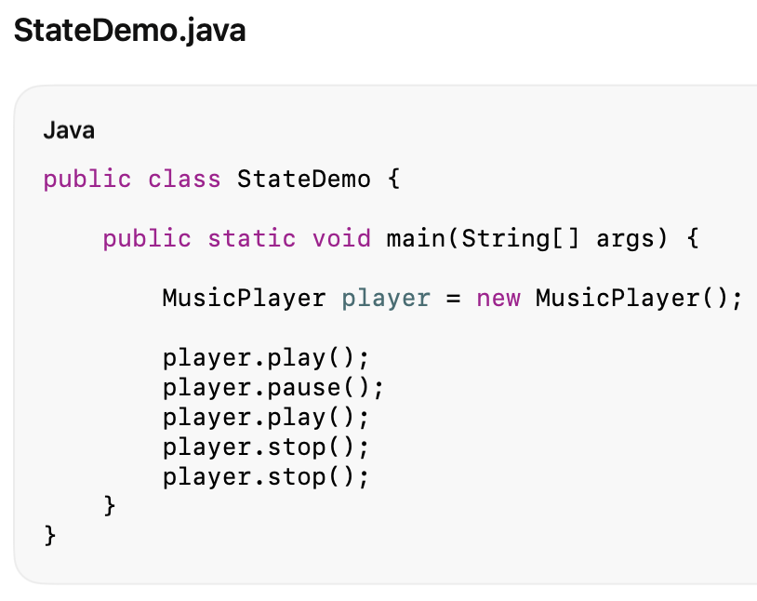
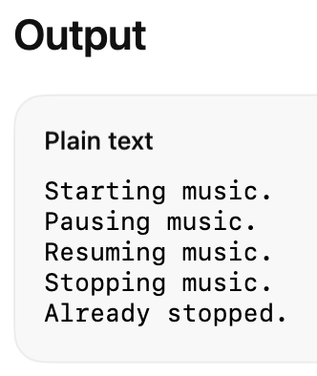
Java Code

Slide 16


Advantages
Eliminates Large Conditional Statements
Instead of:
behavior is delegated to state objects.
Encapsulates State-Specific Behavior
Each state manages its own logic.
Easier to Add New States
Add:
without modifying existing states.
Improves Maintainability
State logic is localized.
Supports Open/Closed Principle
New states can be introduced with minimal changes.
Makes State Transitions Explicit
Transitions are easy to locate and understand.

Slide 17
Disadvantages
Increases Number of Classes
Each state typically requires a separate class.
Can Be Overkill for Simple State Machines
If only two simple states exist, conditionals may be simpler.
State Transitions May Become Scattered
Transitions can be distributed among multiple state classes.
More Objects Created
Large state machines may introduce many objects.

Slide 18
When to Use State Pattern
Object behavior changes significantly based on state
Examples:
Media players
Vending machines
Traffic lights
Network connections
You Have Large Conditional Logic
Many: if(state == ...) statements indicate a potential State Pattern.
State Transitions Are Important
When moving from one state to another is a core business rule.
New States May Be Added Later
The pattern scales well as states grow.

Slide 19
Real-World Examples
Media Players
States:
Playing
Paused
Stopped
Buffering
Vending Machines
States:
NoCoin
HasCoin
Dispensing
SoldOut

Slide 20
Real-World Examples
TCP Connections
States:
Listening
Established
Closed
Online Orders
States:
Created
Paid
Shipped
Delivered
Cancelled

Slide 21
Key Insight
The State Pattern lets an object change its behavior by changing the object that represents its current state.
Instead of asking:
“What state am I in?”
the object delegates work to the current state and lets that state decide how to respond.

